Slide 1



CSA1721- AI CAPSTONE PROJECT
AI-POWERED DOSAGE CALCULATION FOR PERSONALIZED MEDICINE
SIMATS ENGINEERING
SIMATS
GUIDED BY
PROJECT BY
V.Khyathi keerthana
K Haneesha
DR U Arul

Slide 2
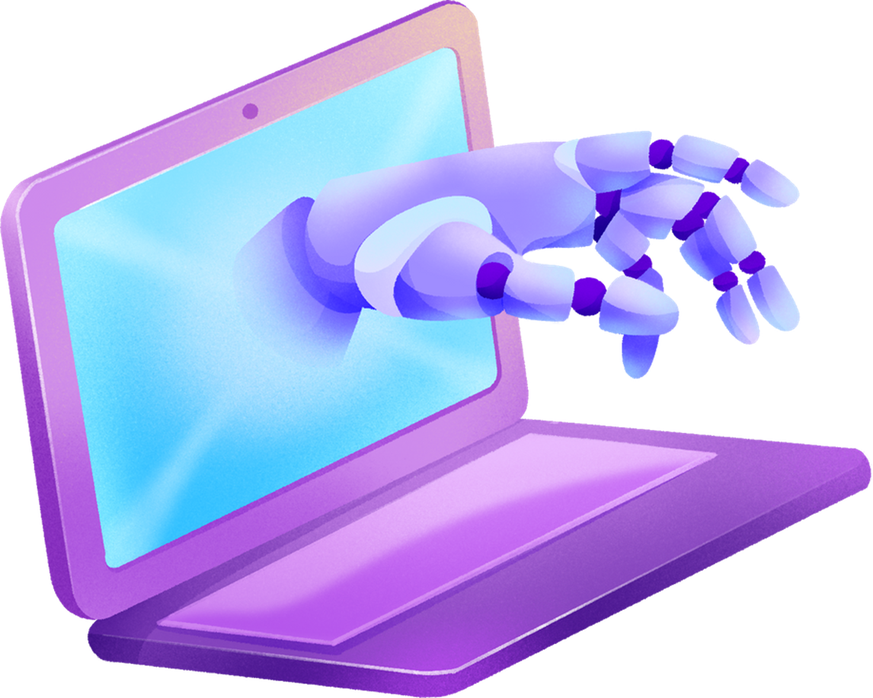

OBJECTIVE
Customize medication doses based on individual patient data.
Adjust doses in real-time based on patient feedback.
Provide precise dosing based on the latest clinical guidelines and evidence.
Reduce the risk of adverse effects through personalized and adaptive dosing.

Slide 3

ABSTRACT
. This AI-powered dosage calculator provides personalized medication recommendations by using patient-specific details like age, weight, and health conditions. It adjusts doses in real-time based on how patients respond to the medication. The system integrates with existing health records and ensures data privacy. Its user-friendly design helps healthcare professionals make accurate dosing decisions. The goal is to improve treatment effectiveness and patient safety.

Slide 4
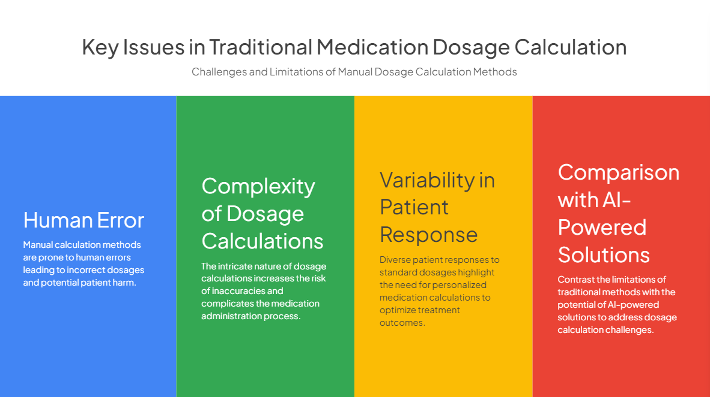

Slide 5
INTRODUCTION
In recent years, artificial intelligence (AI) has begun to revolutionize various fields, and healthcare is no exception. One of the most promising applications of AI in this sector is in the realm of medical dosage. AI-powered medical dosage systems leverage advanced algorithms and machine learning to optimize the administration of medications, ensuring that patients receive the most effective and safe dosages tailored to their individual needs.

Slide 6
EXISTING SYSTEM
IBM Watson for Oncology : Helps doctors to choose the right cancer treatment by analyzing patient data and medical research.
MedAware : Uses AI to spot and prevent mistakes in medication doses by checking prescriptions for errors .
PathAi : Which helps doctors to choose the right dosage by understanding patients condition..

Slide 7
DISADVANTAGES OF EXISTING SYSTEM
AI models may not always account for all individual patient variables, leading to less accurate dosing recommendations, especially in complex or unusual cases.
The effectiveness of AI-powered systems depends on the quality and completeness of the data they are trained on. Inaccurate or incomplete data can lead to incorrect dosing suggestions.
Integrating AI systems with existing healthcare infrastructure (like EHRs) can be technically difficult and may require significant adjustments.

Slide 8

ADVANTAGES OF PROPOSED SYSTEM
Personalized dosages:
The proposed system utilizes patient-specific data and machine learning to calculate personalized medication dosages, leading to more effective and safer treatment outcomes compared to standardized guidelines.
Enhanced accuracy:
By considering factors such as age, weight, health conditions, organ function, and drug interactions, the system improves the accuracy of dosage calculations, reducing the risk of under- or over-dosing.
Improved patient care:
With personalized dosing, patients receive tailored treatment plans that account for their individual characteristics and needs, ultimately improving the quality of care and patient satisfaction.

Slide 9
SYSTEM ARCHITECTURE
Patient-specific Data
Machine Learning Model (AI)
Dosage Calculation and Refinement
Optimal Medication Dosage

Slide 10
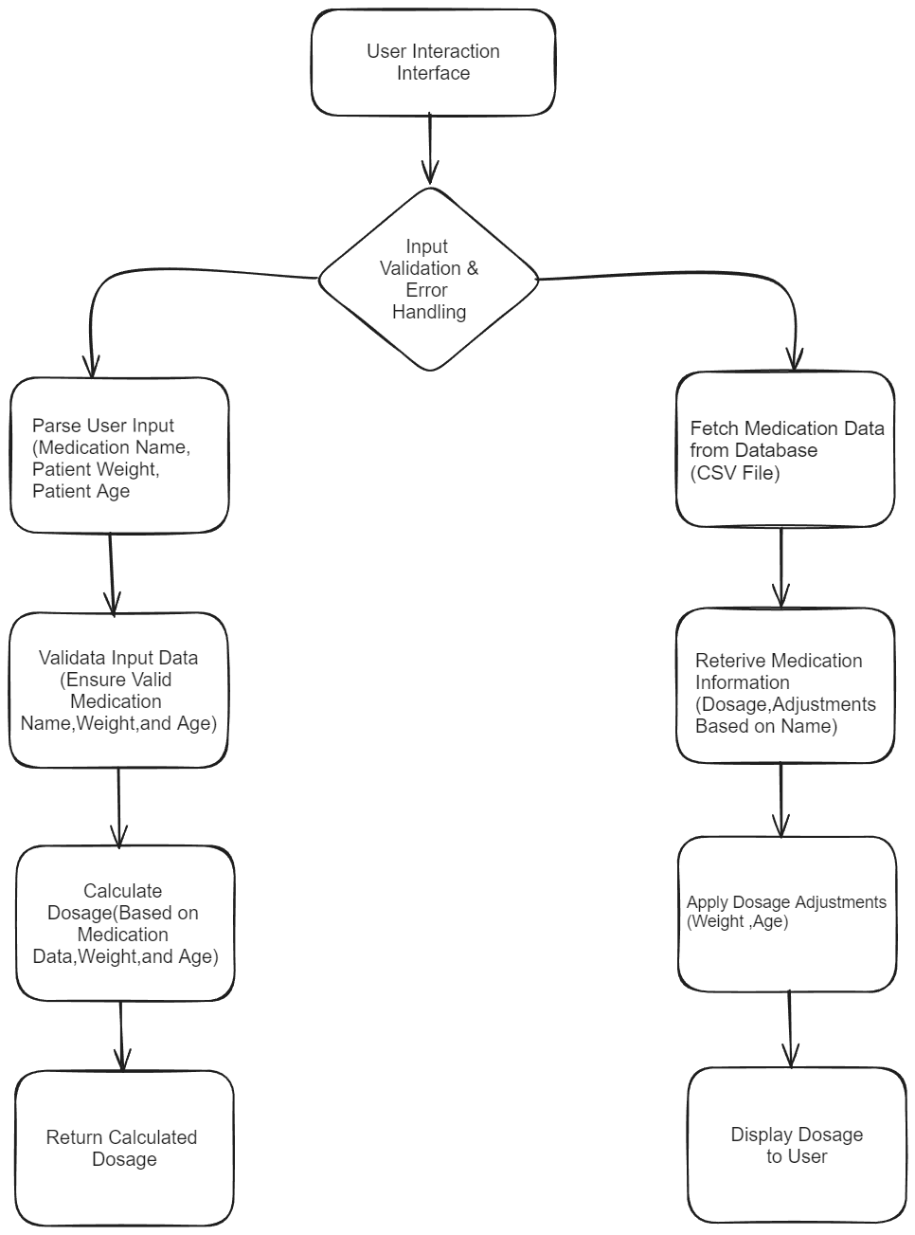
IMPLEMENTATION:
Preparation and Planning
Development and Testing
Integration and Pilot Testing
Evaluation and Optimization
Full-scale Deployment and Monitoring
Continuous Improvement and Expansion

Slide 11
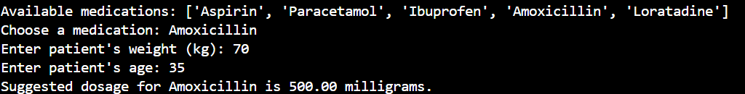
CODE INPUT &OUTPUT:

Slide 12
CONCLUSION
In conclusion, the AI-powered dosage calculation model for personalized medicine offers a promising solution to the limitations of existing dosage calculation methods.
By incorporating patient-specific data and advanced machine learning techniques, the proposed system has the potential to significantly enhance the accuracy and effectiveness of medication dosages.
This innovation could revolutionize the field of healthcare by providing tailored treatment plans that consider individual patient characteristics and needs.
However, further research and validation are needed to ensure the model's effectiveness and safety across diverse patient populations. With continued development and integration into clinical practice, this model has the potential to improve patient outcomes, reduce adverse effects, and advance the field of personalized medicine.

Slide 13
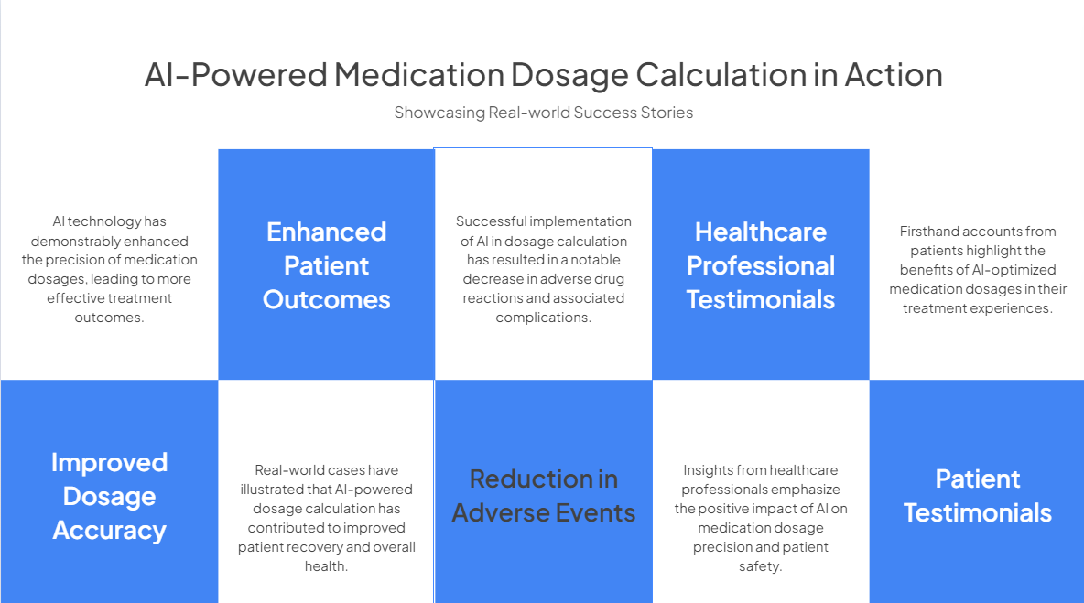

Slide 14
FUTURE WORK
Expansion to other medications and conditions:
The model can be further developed to encompass a wider range of medications and medical conditions, increasing its applicability and impact in healthcare.
Integration with electronic health records (EHRs):
Integrating the dosage calculation model with EHR systems can streamline the prescription process and ensure seamless communication between healthcare providers.
Continuous refinement and validation:
Ongoing refinement and validation of the model using real-world data will be essential to ensure its effectiveness and safety across diverse patient populations.

